Slide 1
Python Module

Slide 2
Why Python Modules?
❌ Without Modules
✅ With Modules
# all_my_code.py (500+ lines!)
def greet(): ...
def add(): ...
def draw_chart(): ...
# greetings.py | math_tools.py
# charts.py | each < 100 lines
Easy to navigate
Reuse across projects
Test independently
Collaborate with a team
Hard to find anything
Hard to share functions
Easy to break by accident
No teamwork possible

Slide 3
What is Python Moduel?
A module is simply a .py file you can import.
📁 Think of a module like a toolbox — each file holds related tools, and you only open the box you need, when you need it.
🏛️ Built-in
📦 Third-party
✍️ Your own
Ships with Python. No install needed.
Made by the community. Install with pip.
Files you write yourself. Save as .py and import!
os, math, random, datetime…
requests, numpy, pandas…
my_tools.py, utils.py…

Slide 4
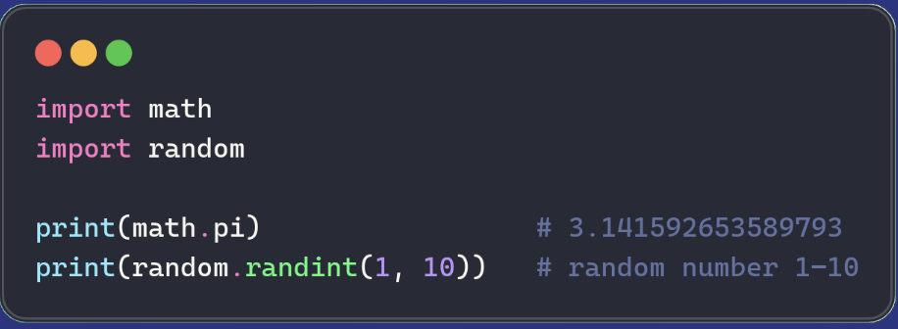
Using Python Modules
1
Type import, then the module name — no quotes needed.
2
Access anything inside using module.something (dot notation).
3
Python searches your project folder then its standard library

Slide 5
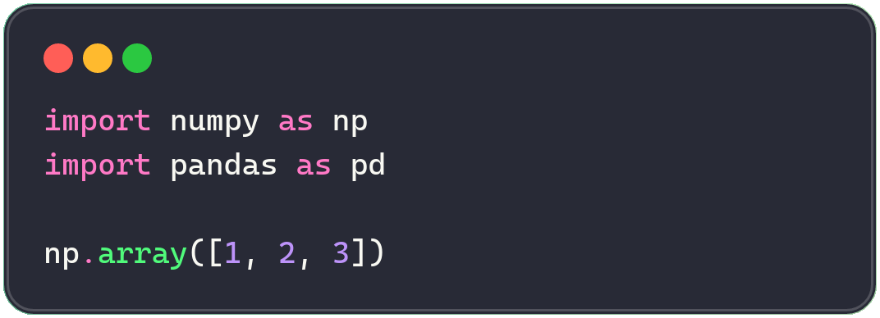
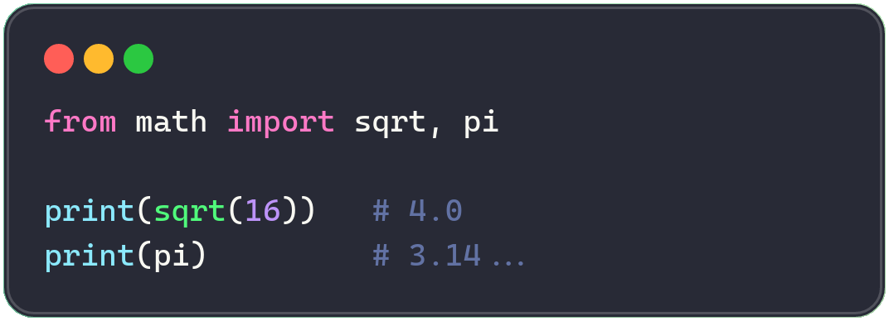
SYNTAX
Using Alias and from...import
import … as (alias)
Give a module a shorter nickname — very common in data science.
from … import
Import only what you need — keeps the namespace clean.
Insight: avoid from math import * — it imports everything and can silently overwrite your own variable names.
5

Slide 6
Python's built-in modules covers most everyday tasks
💻 os
🔢 math
🎲 random
File & folder operations
Math functions & constants
Random numbers & choices
os.listdir('.')
math.sqrt(144)
random.choice(list)
📅 datetime
📄 json
⚙️ sys
Dates and times
Read/write JSON data
Python interpreter info
datetime.date.today()
json.loads(text)
sys.argv[1]

Slide 7
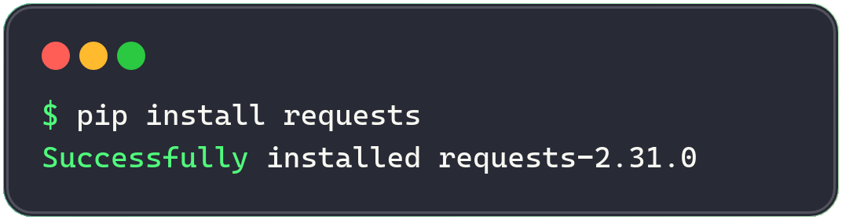
500,000+ Packages via pip install
requests
numpy
pandas
pillow
HTTP calls — fetch web pages & APIs
Fast number crunching & arrays
Spreadsheet-style data analysis
Open, edit & save images

Slide 8
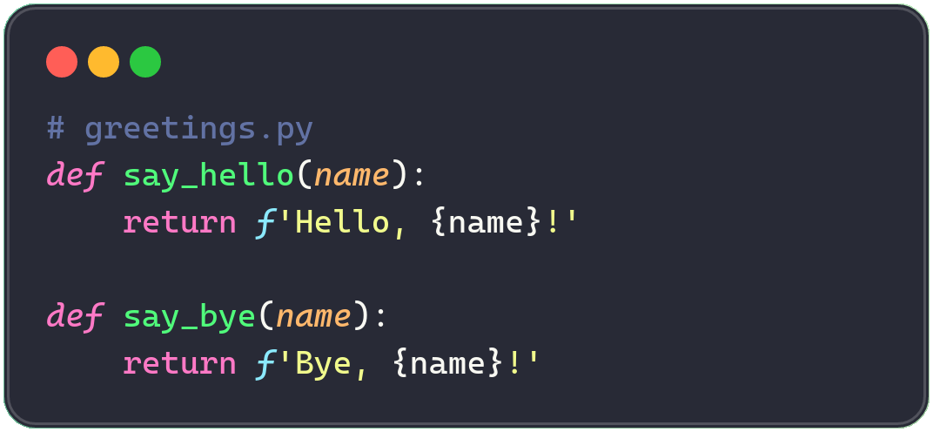
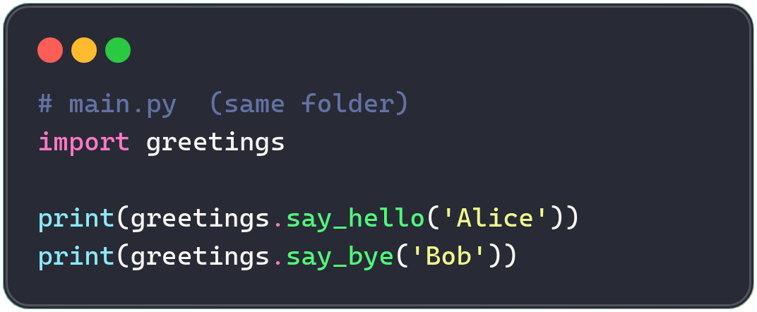
Creating your own module
STEP 1 — Create greetings.py
STEP 2 — Import it in main.py
▶ Output: Hello, Alice! Bye, Bob!

Slide 9
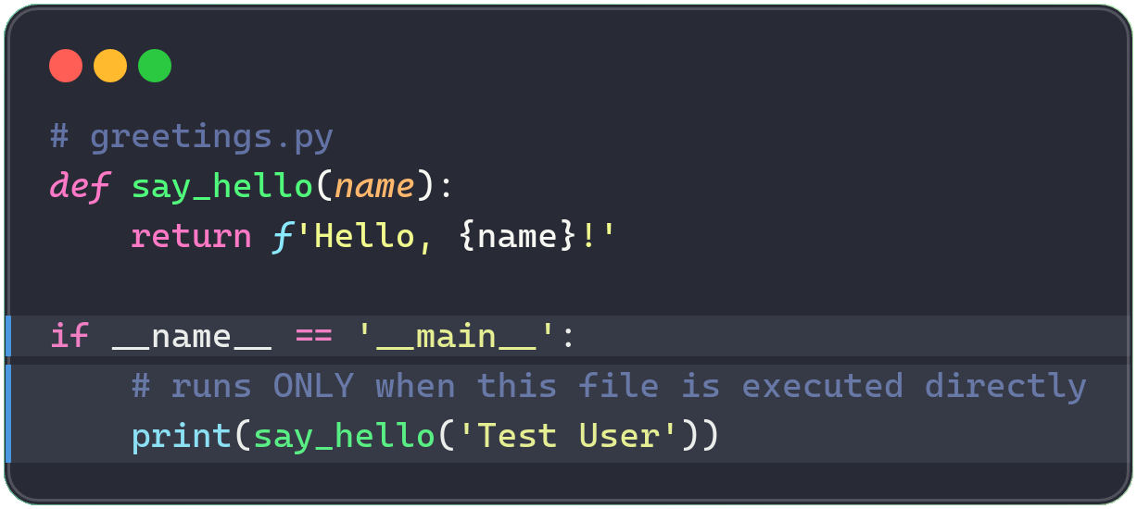
Prevent code from running when import
When you run a file directly, Python sets __name__ to "__main__".
When it's imported, __name__ is the module's file name instead.
✅ run python greetings.py → prints 'Hello, Test User!'
✅ import greetings elsewhere → nothing prints automatically

Slide 10
Practice exercises

Slide 11
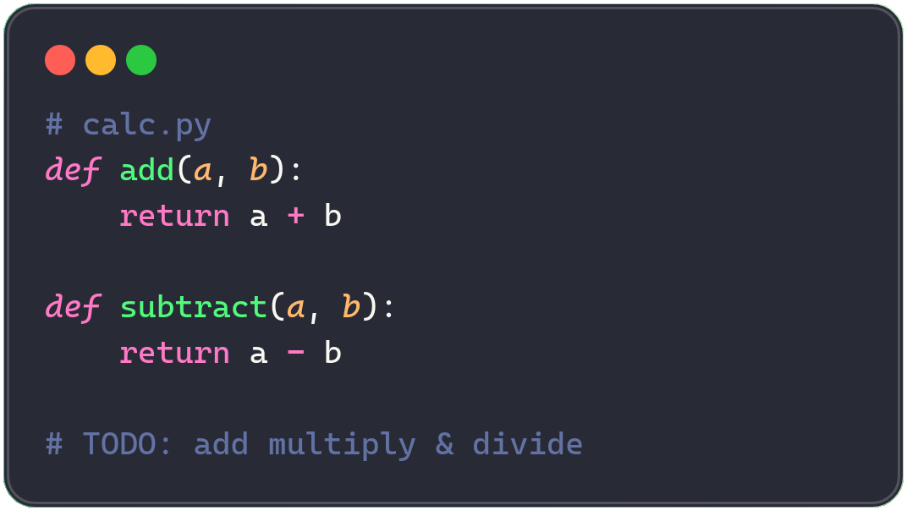
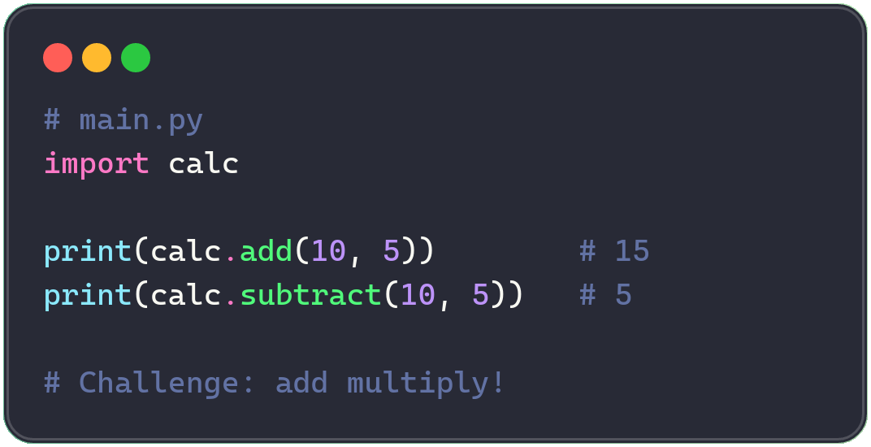
🛠️ TRY IT YOURSELF
Build a Calculator Module in 5 Minutes
📄 calc.py — your module
📄 main.py — use your module
Insight: 🎯 Challenge: add a multiply(a, b) and divide(a, b) function to calc.py.
10

